Slide 1
Ai minor Project :-Ai for market Trend Analysis

Slide 2
Project Topic :-Registered car and 2 wheelers for state Himachal Pradesh since 20 years with condition for below Queries . Expiry of 2 wheelers 20 years and for Car 15 years. Data is uploaded in Git hub for analysis of Queries with registration details of count and price since 2005 to 2025.
Query 1:- Create Sale Forecast on count base and revenue base after expiry of car and 2 wheelers with year on year while there is 5 % increase in price since the start Registration year 2005 @ each year. condition for two wheelers life is 20 years and car is 15 year after registration.
Querry 2:- Create market growth and decline trend analysis on count base in % against registered vehicle going to get expired year on year having potential for resale new vehicle against expired for both 2 wheelers and Car.
Querry 3:- Car used by Girls , woman, man , Boys above age 18 by 10 % ,30%,20%,40% respectively create forecast for car sale potential on gender segment base by using clusters after expiry age is 15 years after registration

Slide 3
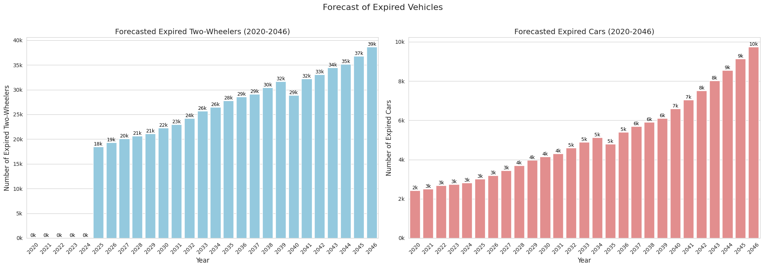
Query 1:-(a) Created Visual Sale Forecast on count base Against Registered two wheelers and Car from 2005 to 2025 base going to get Expire from 2020 till 2046.

Slide 4
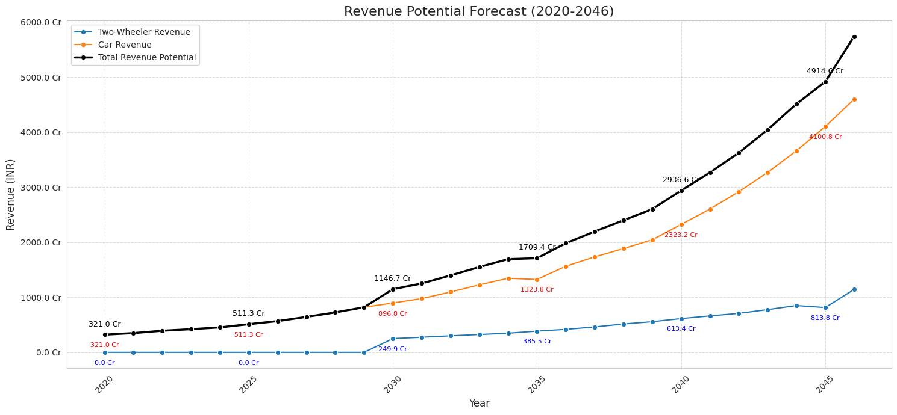
Query 1:-(b) Created Revenue Potential Forecast visual on revenue base after expiry of car and 2 wheelers with year on year while there is 5 % increase in price since the start Registration year 2005 @ each year. condition for two wheelers life is 20 years and car is 15 year after registration.

Slide 5
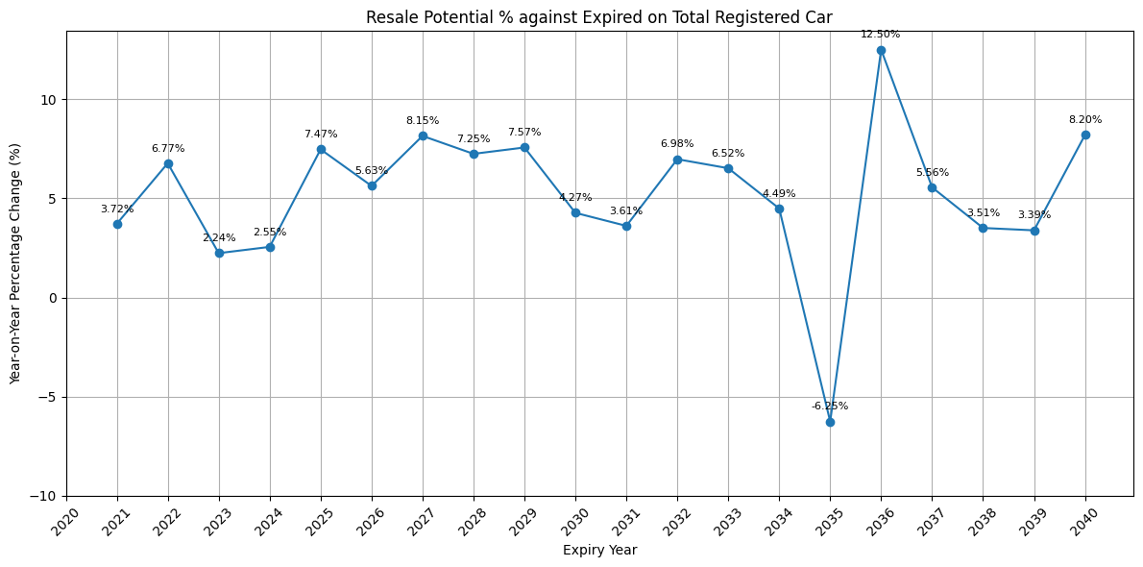
Querry 2:- Created market growth and decline trend analysis Visuals on count base in % against registered vehicle going to get expired year on year having potential for resale new vehicle against expired for Car against total Registered cars since 2005 to 2025 .

Slide 6
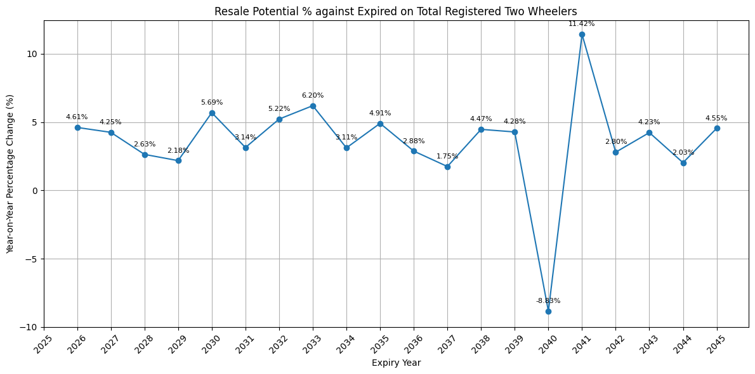
Querry 2:- Create market growth and decline trend analysis on count base in % against registered vehicle going to get expired year on year having potential for resale new vehicle against expired 2 wheelers against total Registered two wheelers since 2005 to 2025 .

Slide 7
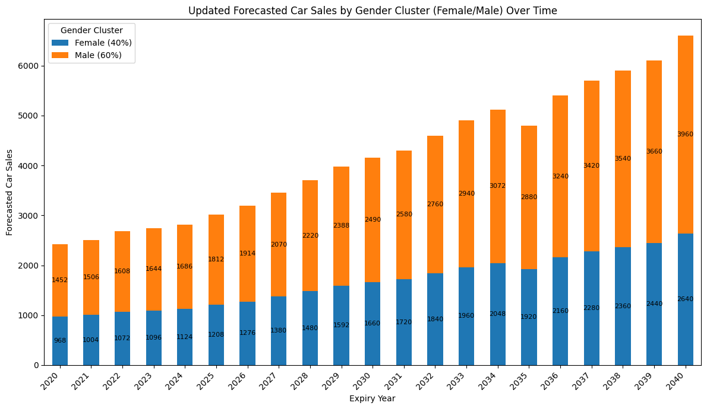
Querry 3 :- Cars used by Girls , woman, man , Boys above age 18 create by 10 % ,30%,20%,40% respectively created Visual forecast for car on count base having sale potential on gender segment (Male and Female) base by using clusters after expiry age is 15 years after registration .

